Slide 1
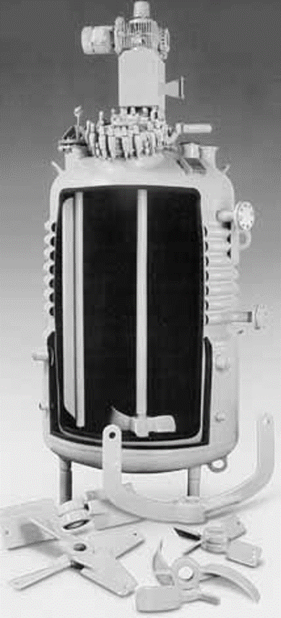
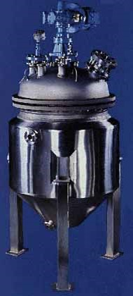
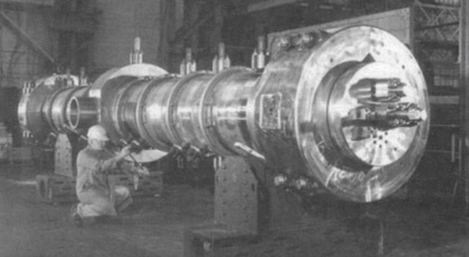
L2b: Reactor Molar Balance Example Problems
F_{j0}
F_{j}
G_{j}
reactor
Today we will use BMB to derive reactor design equations. Your goal is to learn this process, not to memorize the equations!

Slide 2
Review: Basic Molar Balance BMB
Rate of generation of j by chemical rxn
[moles/time]
Rate of accumulation of j in the system
[moles/time]
Rate of flow of j
into the system
[moles/time]
Rate of flow of j out of system
[moles/time]
-
+
=
F_{j0}
F_{j}
G_{j}
F_{j0}
F_{j}
G_{j}
System volume

Slide 3
Review: Batch Reactor Basic Mole Balance
No material enters or leaves the reactor
In ideal reactor, composition and temperature are spatially uniform (i.e. perfect mixing)
No flow in or out of reactor. F_{j0} and F_{j} = 0.
Rate of generation of reactant A in reactor due to rxn
Rate of accumulation of
reactant A in reactor
=
Batch Reactor Design Equation
Ideal (perfectly mixed) reactor: spatially uniform temp, conc, & reaction rate
Ideal Batch Reactor Design Equation

Slide 4
Review: CSTR Basic Mole Balance
Continuously add reactants and remove products
In an ideal reactor, composition and temperature are spatially uniform (i.e. perfect mixing)
At steady state- no accumulation
F_{j0}
F_{j}
Accumulation = In - Out + Generation
by rxn
0 = F_{j0} - F_{j} +
No spatial variation:
Ideal Steady State CSTR Design Equation:
in terms of flow
in terms of concentration
υ (upsilon)

Slide 5
Review: Mole Balance – PFR
Flow reactor operated at steady state (no accumulation per Δ)
Composition of fluid varies down length of reactor (material balance for differential element of volume ΔV
ΔV
F_{A0}
F_{A}
F_{j0}
-
F_{j}
+
=
Ideal SS PFR Design Eq.

Slide 6
Review: Mole Balance- Packed Bed Reactor (PBR)
Heterogeneous rxn: reaction occurs at catalyst particle surface
Concentration gradient of reactant and product change down length of the reactor
Rxn rate based on the mass of catalyst W, not reactor volume V
Similar to PFR, but expressed in terms of catalyst weight instead of reactor volume
Units for the rate of a homogeneous rxn (r_{j}) :
Units for the rate of a catalytic rxn (r_{j}’) :
So in terms of catalyst weight instead of reactor volume:

Slide 7
Consider a reaction that occurs on a catalyst surface (a heterogeneous rxn). How is the reaction rate r’_{j} that is in terms of the weight of catalyst related to the rate in terms of volume (r_{j})?
Hint: r_{j} = x r’_{j}
What is x?
Rearrange to solve for x
Bulk catalyst density
r_{j} = ρ_{b} r’_{j}

Slide 8
Use your result from the previous question to derive a reactor design equation for a fluidized CSTR containing catalyst particles. The equation should be in terms of catalyst weight (W) and the reaction rate for an equation that uses solid catalyst. Assume perfect mixing and steady-state operation of the CSTR.
-
In
Out
Gen
Accumulation
What is the CSTR design equation?
+
=
Rearrange to put in terms of V
0

Slide 9
Use your result from the previous question to derive a reactor design equation for a fluidized CSTR containing catalyst particles. The equation should be in terms of catalyst weight (W) and the reaction rate for an equation that uses solid catalyst. Assume perfect mixing and steady-state operation of the CSTR.
Need an equation that has W instead of V and –r_{j}’ instead of -r_{j}
CSTR design equation:
Step 1: Come up with an equation that relates V to W (V=?W) & substitute this equivalency into the CSTR design equation.
Substitute W/ρ_{b} for V in design eq:
Step 2: Substitute an expression that relates –r_{j} to –r_{j}’ into the design eq:
Units for r_{j}:
Units for r_{j}’:
From the previous question:
r_{j} = ρ_{b} r’_{j}
Ideal Fluidized CSTR Design Equation
Simplify:

Slide 10
Use basic molar balance to derive a reactor design equation for a fluidized CSTR containing catalyst particles. The equation should be in terms of catalyst weight (W) and the reaction rate for an equation that uses solid catalyst. Assume perfect mixing and steady-state operation of the CSTR.
-
In
Out
+
Generation
Accumulation
=
Simplify this expression. Things to consider: Is there flow? Accumulation? Is the reaction rate the same everywhere in the reactor?
At steady state
0
Rearrange to get in terms of W
Ideal Fluidized CSTR Design Equation

Slide 11
The reaction A→B is to be carried out isothermally in a continuous-flow reactor. Calculate the CSTR volume to consume 99% of A (C_{A}=0.01C_{A0}) when the entering molar flow rate is 5 mol A/h, the volumetric flow rate is constant at 10 dm³/h and the rate is –r_{A}=(3dm³/mol•h)C_{A}².
υ₀ = 10 dm³/h = υ
reactor
F_{A0}=5 mol A/h
F_{A}=υC_{A} where C_{A} = 0.01C_{A0}
CSTR design eq:
-
In
Out
Gen
Accumulation
+
=
0
Substitute in:
–r_{A}=(3dm³/mol•h)C_{A}² & C_{A}=0.01C_{A0}
Factor
numerator
We know υ. What is C_{A0?}

Slide 12
The reaction A→B is to be carried out isothermally in a continuous-flow reactor. Calculate the PFR volume to consume 99% of A (C_{A}=0.01C_{A0}) when the entering molar flow rate is 5 mol A/h, the volumetric flow rate is constant at 10 dm³/h and the rate is –r_{A}=(3dm³/mol•h)C_{A}².
υ₀ = 10 dm³/h = υ
reactor
F_{A0}=5 mol A/h
F_{A}=υC_{A} where C_{A} = 0.01C_{A0}
PFR design eq:
Substitute in: –r_{A}=(3dm³/mol•h)C_{A}² but not C_{A}=0.01C_{A0} until after integration!
REVIEW:
for n≠1:
Much smaller V required to get same conversion in a PFR than in a CSTR

Slide 13
The gas phase reaction A→B+C will be carried out isothermally in a 20 dm³ constant volume, well-mixed batch reactor. 20 moles of pure A is initially placed in the reactor. If the rate is –r_{A}=kC_{A} and k=0.865 min⁻¹, calculate the time needed to reduce the number of moles of A in the reactor to 0.2 mol. DDDD
Batch reactor
design eq
-
Accum
In
Out
Gen
+
=
0
0
Need to convert to dC_{A}/dt
How is dC_{A}/dt related to dN_{A}/dt?
Plug into design eq
0
Plug in rate law
Rearrange & integrate
REVIEW:
for n=1:
Convert C_{j} back to N_{j}/V
Substitute in values for k, N_{A0}, & N_{A}

Slide 14
Polymath example problem 1-17
There are initially 500 rabbits (x) and 200 foxes (y). Use Polymath to plot the number of rabbits and foxes as a function of time for a period of up to 500 days. The predator-prey relationship is given by the following coupled ODEs:
Constant for growth for rabbits k₁= 0.02 day⁻¹
Constant for death of rabbits k₂=0.00004/(day∙number of foxes)
Constant for growth of foxes after eating rabbits k₃=0.0004/(day∙number of rabbits)
Constant for death of foxes k₄= 0.04 day⁻¹
Also, what happens if k₃=0.00004/day and t=800 days? Plot the number of foxes vs rabbits.

Slide 15
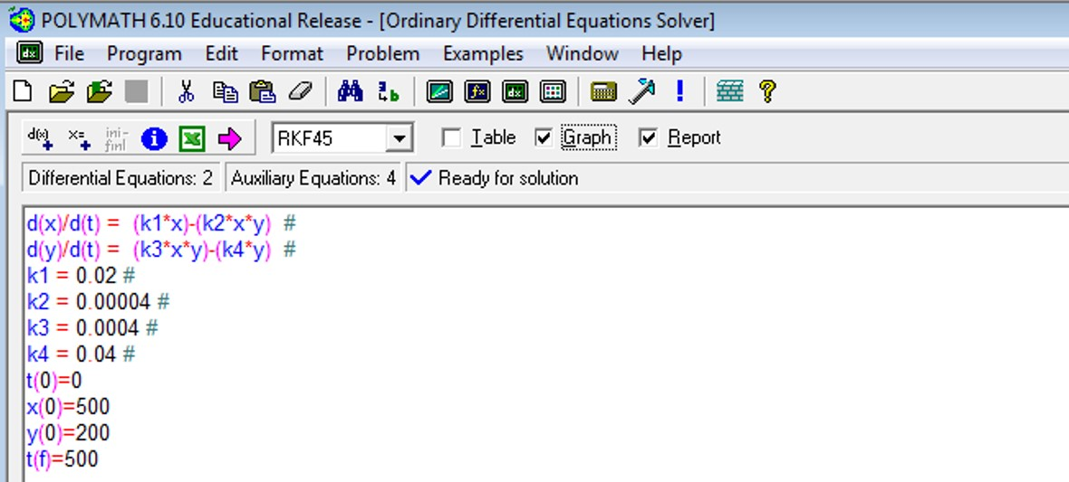
Initially 500 rabbits (x) and 200 foxes (y). Predator-prey relationship is given by the following coupled ODEs:
Constant for growth of rabbits: k₁= 0.02 day⁻¹
Constant for death of rabbits: k₂=0.00004/(day∙number of foxes)
Constant for growth of foxes after eating rabbits k₃=0.0004/(day∙number of rabbits)
Constant for death of foxes k₄= 0.04 day⁻¹
t= 0 to 500 days
Make sure the “Graph” and “Report” buttons are checked above
After typing in the 2 differential equations, conditions for t=0, constants, and initial and final time pts, press the magenta arrow to solve

Slide 16
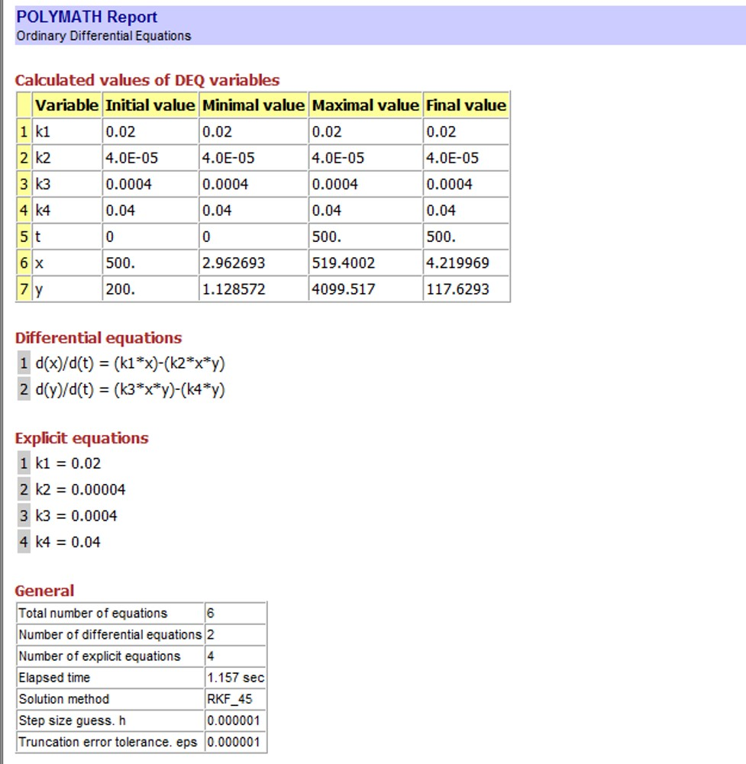
Polymath report:
Number of rabbits at 500 days
Number of foxes at 500 days

Slide 17
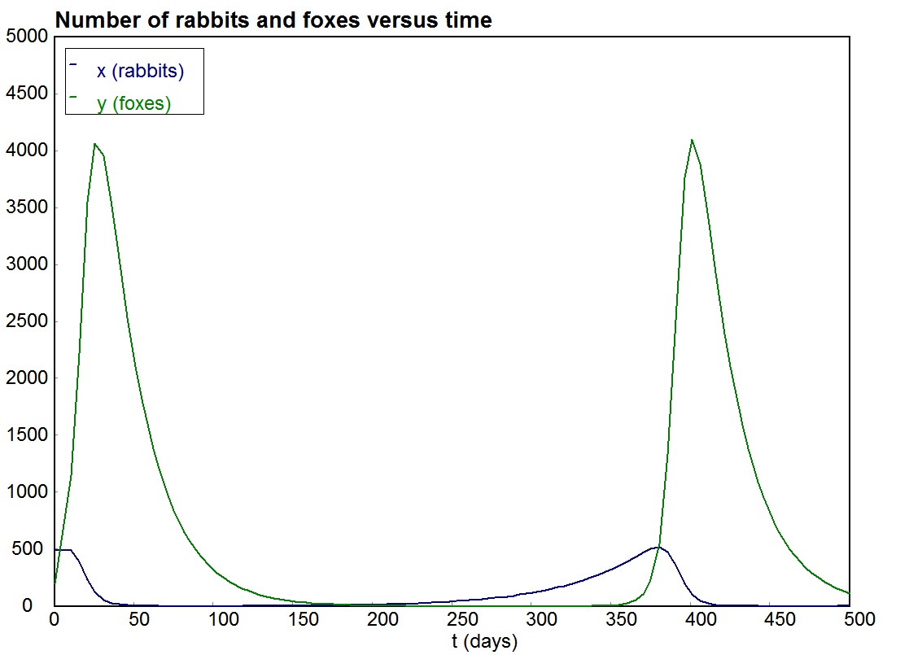
Polymath graph:

Slide 18
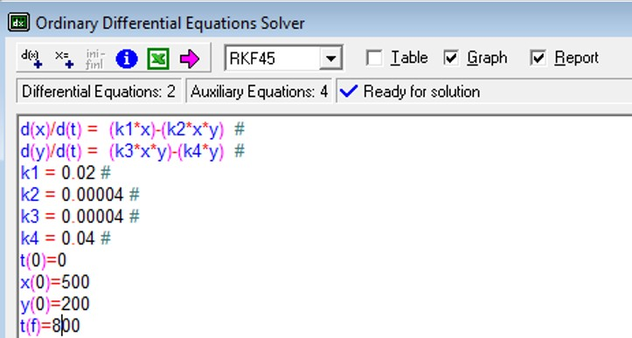
What happens if k₃=0.00004/day and t=800 days? Plot the number of foxes vs rabbits.
Make sure the “Graph” and “Report” buttons are checked above
After changing t(f) to 800 and k3 to 0.00004, press the magenta arrow to solve

Slide 19
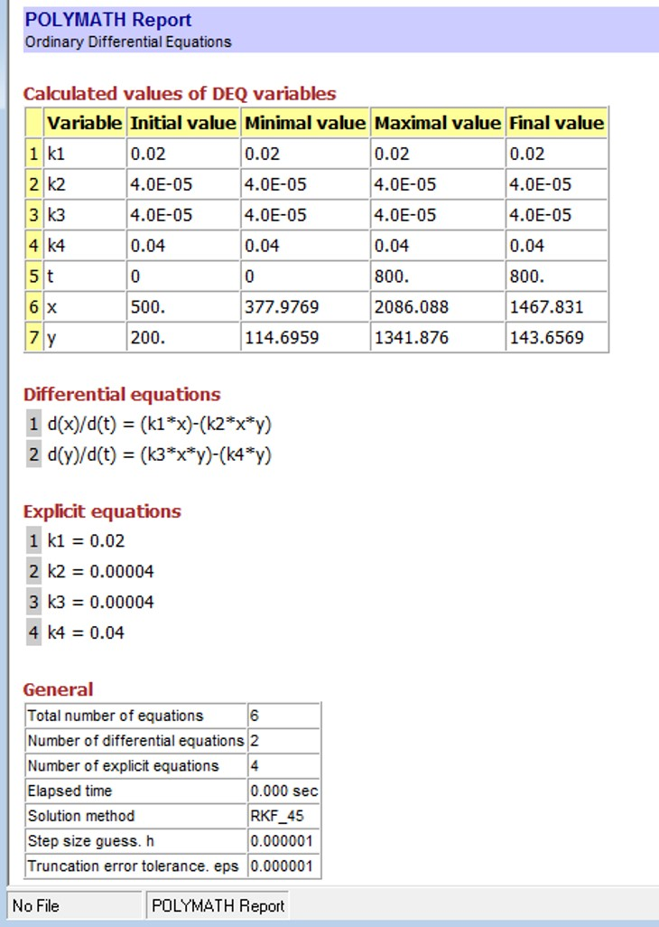
Number of rabbits at 800 days
Number of foxes at 800 days

Slide 20
